Slide 1
Lucru cu fisiere
Cursul II

Slide 2
NTFS Filesystem
Un HDD e o insiruire de valori de 0 si 1.
Totusi, avem partitii si pe fiecare partitie avem fisiere si directoare
Cum apare aceasta translatare ? E mai mult decat 0 si 1?
Filesystem

Slide 3
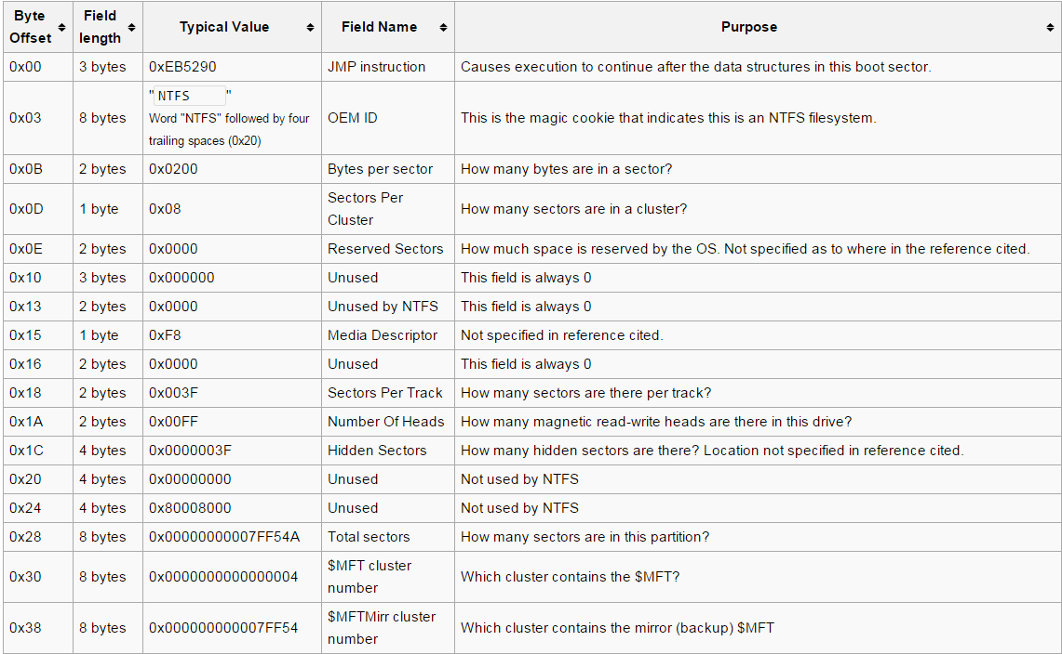
NTFS Filesystem

Slide 4
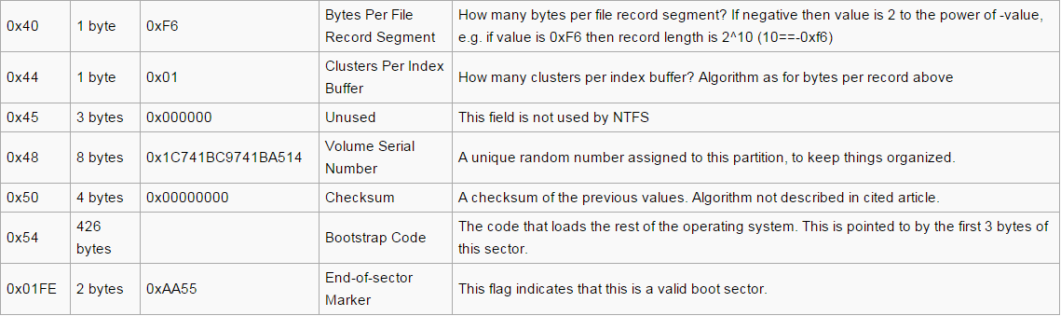
NTFS Filesystem

Slide 5
NTFS Filesystem
fsutil fsinfo ntfsinfo c:
NTFS Volume Serial Number : 0x8a3646b136469e57
Version : 3.1
Number Sectors : 0x000000001dcf1fff
Total Clusters : 0x0000000003b9e3ff
Free Clusters : 0x00000000013a77c7
Bytes Per Sector : 512
Bytes Per Physical Sector : 512
Bytes Per Cluster : 4096
Bytes Per FileRecord Segment : 1024
Mft Valid Data Length : 0x0000000014440000
Mft Start Lcn : 0x00000000000c0000
Mft2 Start Lcn : 0x0000000000000002
RM Identifier: 16F40BE1-9512-11E4-8D36-9A8DA172D3E5

Slide 6
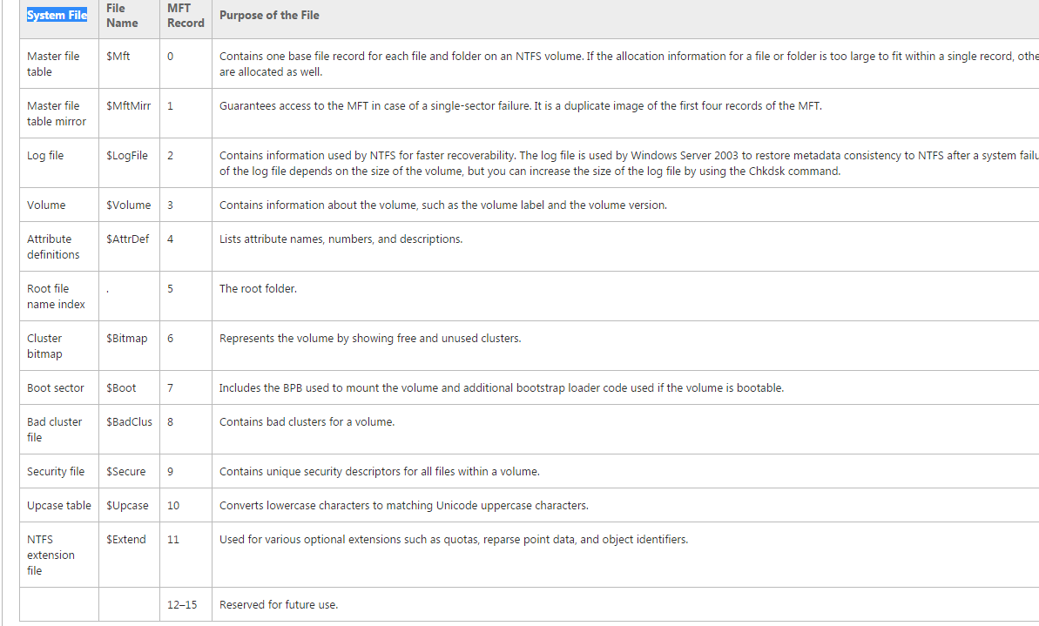

Slide 7
MFT FILE

Slide 8
typedef struct _NTFS_MFT_FILE_ENTRY_HEADER {
char fileSignature[4]; //Magic Number: "FILE"
WORD wFixupOffset;//Offset to the update sequence.
WORD wFixupSize;//Number of entries in fixup array
LONGLONG n64LogSeqNumber;//$LogFile Sequence Number (LSN)
WORD wSequence;//Sequence number
WORD wHardLinks;//Hard link count
WORD wAttribOffset;//Offset to first attribute
WORD wFlags;//Flags: 0x01: record in use, 0x02 directory.
DWORD dwRecLength;//Used size of MFT entry
DWORD dwAllLength;//Allocated size of MFT entry.
LONGLONG n64BaseMftRec;//File reference to the base FILE record
WORD wNextAttrID;//Next attribute ID
WORD wFixupPattern;//Align to 4B boundary
DWORD dwMFTRecNumber;//Number of this MFT record
} NTFS_MFT_FILE_ENTRY_HEADER, *P_NTFS_MFT_FILE_ENTRY_HEADER;

Slide 9
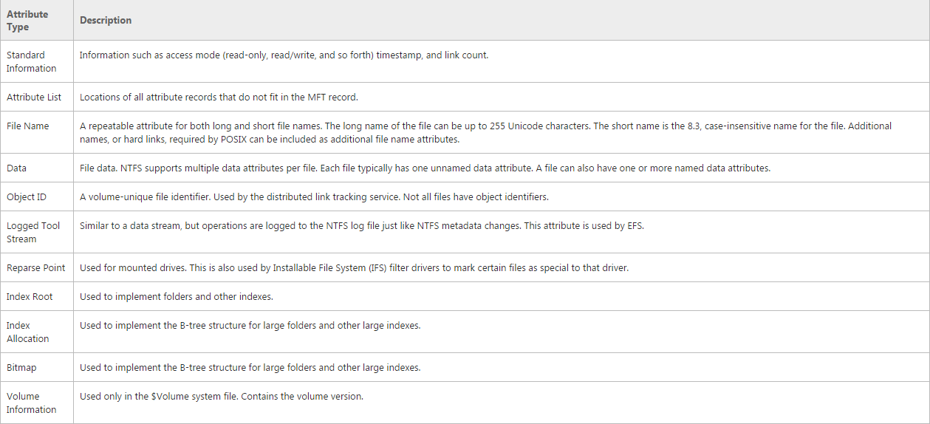

Slide 10
typedef struct _NTFS_ATTRIBUTE {
DWORD dwType;// type of the attribute
DWORD dwFullLength; //total size of the attribute
BYTE uchNonResFlag; // the attribute is resident or not
BYTE uchNameLength; // if there is an additional name for the attribute
WORD wNameOffset; //the offset where the name can be found
WORD wFlags; // flags of the attribute
WORD wID; // the current if in this file for this attribute

Slide 11
union ATTR {
struct RESIDENT {
DWORD dwLength;//the total length from here
WORD wAttrOffset;//attribute offset – to start read from
BYTE uchIndexedTag; //reserved
BYTE uchPadding;//reserved
} Resident;

Slide 12
struct NONRESIDENT {
LONGLONG n64StartVCN;//start of logical cluster number
LONGLONG n64EndVCN;//end of logical cluster number
WORD wDatarunOffset;//from where data run starts
WORD wCompressionSize;//reserved
BYTE uchPadding[4];
LONGLONG n64AllocSize; //The allocated size of the file, in bytes.
LONGLONG n64RealSize;//total size of the file – this and above not valid if //nStartVCN not 0
LONGLONG n64StreamSize;
} NonResident;
} Attr;
} NTFS_ATTRIBUTE, *P_NTFS_ATTRIBUTE;

Slide 13
Informatii suplimentare
Cum sa extragi nonresident attributes:
https://msdn.microsoft.com/en-us/library/bb470039(v=vs.85).aspx – zona Remarks
Mai multe informatii despre file systems in general:
http://www.campus64.com/digital_learning/data/cyber_forensics_essentials/info_file_system_forensic_analysis.pdf

Slide 14
typedef struct _NTATTR_STANDARD_INDEX_HEADER {
char magicNumber[4]; //INDX
unsigned short updateSeqOffs;
unsigned short sizeOfUpdateSequenceNumberInWords;
LONGLONG logFileSeqNum;
LONGLONG vcnOfINDX;
DWORD indexEntryOffs;
DWORD sizeOFEntries;
DWORD sizeOfEntryAlloc;
BYTE flags;
BYTE padding[3];
unsigned short updateSeq;
} NTATTR_STANDARD_INDEX_HEADER, *P_NTATTR_STANDARD_INDEX_HEADER;

Slide 15
typedef struct __NTFS_ATTRIBUTE_FILE_NAME
{
ULONGLONG u64ParentReferenceNumber;
ULONGLONG u64CreationTime;
ULONGLONG u64ModifyTime;
ULONGLONG u64MftTime;
ULONGLONG u64LastAccessTime;
ULONGLONG u64AllocatedSize;
ULONGLONG u64RealSize;
DWORD dwFlags;
DWORD dwReparse;
unsigned char uchLength;
unsigned char uchNameConvention;
wchar_t FileName[1];
}NTFS_ATTRIBUTE_FILE_NAME;

Slide 16
Data attribute

Slide 17
CreateFILE
HANDLE WINAPI CreateFile( _In_ LPCTSTR lpFileName,//numele fisierului de
//deschis
_In_ DWORD dwDesiredAccess, //drepturi de acces
_In_ DWORD dwShareMode, //drepturi de sharing
_In_opt_ LPSECURITY_ATTRIBUTES lpSecurityAttributes, //attribute de securitate
_In_ DWORD dwCreationDisposition, //modul de creare
_In_ DWORD dwFlagsAndAttributes, //flaguri si atribute
_In_opt_ HANDLE hTemplateFile ); //template file
*Prezentare exemplu

Slide 18
ReadFILE
BOOL WINAPI ReadFile(
_In_ HANDLE hFile,//handle obtinut cu CreateFile
_Out_ LPVOID lpBuffer,//bufferul unde urmeaza sa fie citit
_In_ DWORD nNumberOfBytesToRead,//numarul de //bytes de citit
_Out_opt_ LPDWORD lpNumberOfBytesRead,//numarul de //bytes citit efectiv
_Inout_opt_ LPOVERLAPPED lpOverlapped//overlapped – //folosibil pentru operatii asincrone
);

Slide 19
TESTARE EOF
BOOL bResult = ReadFile(hFile, buffer, bytesToRead, &nBytesActuallyRead, NULL);
If (bResult && !nBytesActuallyRead)
{
//end of file
}

Slide 20
WriteFILE
BOOL WINAPI WriteFile (
_In_ HANDLE hFile,
_In_ LPCVOID lpBuffer,
_In_ DWORD nNumberOfBytesToWrite,
_Out_opt_ LPDWORD lpNumberOfBytesWritten,
_Inout_opt_ LPOVERLAPPED lpOverlapped
);

Slide 21
CLOSEHANDLE
CloseHandle(hFile);

Slide 22
Standard HANDLEs
STD_INPUT_HANDLE
STD_OUTPUT_HANDLE
STD_ERROR_HANDLE
HANDLE hStdHandle = GetStdHandle(id);

Slide 23
practic
Sa se implementeze comanda cat. Se scrie un program care primeste ca parametru un nume de fisier. Se deschide acel fisier, se citesc cate 4k din acel fisier si se afiseaza la standard output.

Slide 24
Practic
Rulati comanda Start /B TestFile.exe
Rulati cat pe fisierul test_file.txt
Incercati sa vedeti ce e in fisierul test_file.txt
Incercati sa il stergeti
De ce?

Slide 25
ADS – alternate data streams
Cream un fisier test.txt
Il deschidem cu notepad si scriem un text
Tastam echo “This is a stream” > test.txt:mystream.txt
Apelam dir – parca nu s-a intamplat nimic si totusi …
Notepad test.txt:mystream.txt ne arata un fisier

Slide 26
FindfirstSTREAmW
HANDLE WINAPI FindFirstStreamW(
_In_ LPCWSTR lpFileName,
_In_ STREAM_INFO_LEVELS InfoLevel,
_Out_ LPVOID lpFindStreamData,
_Reserved_ DWORD dwFlags
);

Slide 27
FindNextStreamw
BOOL WINAPI FindNextStreamW(
_In_ HANDLE hFindStream,
_Out_ LPVOID lpFindStreamData
);
typedef struct _WIN32_FIND_STREAM_DATA {
LARGE_INTEGER StreamSize;
WCHAR cStreamName[MAX_PATH + 36];
} WIN32_FIND_STREAM_DATA, *PWIN32_FIND_STREAM_DATA;
In final handleul de enumerare trebuie inchis cu FindClose(handle);

Slide 28
Practic
Sa se enumere toate streamurile unui fisier, daca exista. Numele fisierului va fi primit ca si parametru din linia de comanda.

Slide 29
Schimbarea pozitiei in fisier
DWORD WINAPI SetFilePointer(
_In_ HANDLE hFile,
_In_ LONG lDistanceToMove,
_Inout_opt_ PLONG lpDistanceToMoveHigh,
_In_ DWORD dwMoveMethod
);
FILE_BEGIN
FILE_CURRENT
FILE_END
FSUtil File CreateNew sparse.txt 0x10000000
FSUtil Sparse SetFlag sparse.txt
FSUtil Sparse SetRange sparse.txt 0 0x10000000

Slide 30
GetFILEATTRIBUTES
DWORD WINAPI GetFileAttributes(
_In_ LPCTSTR lpFileName
);
https://msdn.microsoft.com/en-us/library/windows/desktop/gg258117(v=vs.85).aspx

Slide 31
Enumerarea elementelor unui director
HANDLE WINAPI FindFirstFile(
_In_ LPCTSTR lpFileName,
_Out_ LPWIN32_FIND_DATA lpFindFileData
);
typedef struct _WIN32_FIND_DATA {
DWORD dwFileAttributes;
FILETIME ftCreationTime;
FILETIME ftLastAccessTime;
FILETIME ftLastWriteTime;
DWORD nFileSizeHigh;
DWORD nFileSizeLow;
DWORD dwReserved0;
DWORD dwReserved1;
TCHAR cFileName[MAX_PATH];
TCHAR cAlternateFileName[14];
} WIN32_FIND_DATA, *PWIN32_FIND_DATA, *LPWIN32_FIND_DATA;

Slide 32
Findnextfile
BOOL WINAPI FindNextFile(
_In_ HANDLE hFindFile,
_Out_ LPWIN32_FIND_DATA lpFindFileData
);
FindClose – pentru a inchide enumerarea

Slide 33
Practic
Sa se copieze un director in alt director . Directorul sursa si directorul destinatie se primesc ca parametri. Functie ajutatoare:
BOOL WINAPI CreateDirectory(
_In_ LPCTSTR lpPathName,
_In_opt_ LPSECURITY_ATTRIBUTES lpSecurityAttributes
);

Slide 34
MoveFile*
BOOL WINAPI MoveFile(
_In_ LPCTSTR lpExistingFileName,
_In_ LPCTSTR lpNewFileName
);
BOOL WINAPI MoveFileEx(
_In_ LPCTSTR lpExistingFileName,
_In_opt_ LPCTSTR lpNewFileName,
_In_ DWORD dwFlags
);
MOVEFILE_COPY_ALLOWED
MOVEFILE_DELAY_UNTIL_REBOOT
MOVEFILE_REPLACE_EXISTIN
MOVEFILE_WRITE_THROUGH
HKEY_LOCAL_MACHINE\SYSTEM\CurrentControlSet\Control\
Session Manager\PendingFileRenameOperations

Slide 35
Practic
Sa se stearga cu MoveFileEx fisierul care nu putea fi sters dupa rularea TestFile.exe

Slide 36
Alte functii de lucru cu fisiere
BOOL WINAPI GetFileSizeEx(
_In_ HANDLE hFile,
_Out_ PLARGE_INTEGER lpFileSize
);
BOOL WINAPI GetFileTime(
_In_ HANDLE hFile,
_Out_opt_ LPFILETIME lpCreationTime,
_Out_opt_ LPFILETIME lpLastAccessTime,
_Out_opt_ LPFILETIME lpLastWriteTime
);
BOOL WINAPI SetFileTime(
_In_ HANDLE hFile,
_In_opt_ const FILETIME *lpCreationTime,
_In_opt_ const FILETIME *lpLastAccessTime,
_In_opt_ const FILETIME *lpLastWriteTime
);

Slide 37
practic
Sa se copieze fisierele din exemplu cu copierea directoarelor pastrandu-se timpii fisierelor.

Slide 38
Practic
Sa se gaseasca fisierele duplicate dintr-un director.

Slide 39
Bibliografie
https://msdn.microsoft.com/en-us/
http://www.campus64.com/digital_learning/data/cyber_forensics_essentials/info_file_system_forensic_analysis.pdf
http://0cch.net/ntfsdoc/attributes/
http://www.grayscale-research.org/new/pdfs/Exploring%20NTFS.pdf
http://www.cse.scu.edu/~tschwarz/coen252_07Fall/Lectures/NTFS.html
https://technet.microsoft.com
BITDEFENDER forensics

